Slide 1

Book Recommender
By Hugo Perdomo

Slide 2




Who am I
Background in Computer Science
Worked with SAP implementations and development
Passionate about exploring data and finding solutions
hugo.perdomo@gmail.com
https://www.linkedin.com/in/hugo-perdomo/
https://github.com/hapl/

Slide 3

Motivation
Improve knowledge related to:
Recommenders
Natural Language Processing
Sentiment Analysis
APIs

Slide 4
Project Workflow
EDA
Data Cleaning
Feature Engineering
Recommender Creation
Data Wrangling

Slide 5

Data Wrangling
Graph file in json format
Download files
Transform data for use in project
Goodreads json data extracted by the University of California San Diego(UCSD).
Data from 1.3+ million books
Took data for books with more than 40 reviews (550+ thousand books)
Data from reviews 15+ million reviews.
Extracted reviews related to books selected.
Notes:
The datasets were collected in late 2017 from goodreads.com, where we only scraped users' public shelves, i.e. everyone can see it on web without login. User IDs and review IDs are anonymized.
We collected these datasets for academic use only. Please do not redistribute them or use for commercial purposes.
If you are using our datasets, please cite the following papers:
Mengting Wan, Julian McAuley, "Item Recommendation on Monotonic Behavior Chains", in RecSys'18. [bibtex]
Mengting Wan, Rishabh Misra, Ndapa Nakashole, Julian McAuley, "Fine-Grained Spoiler Detection from Large-Scale Review Corpora", in ACL'19. [bibtex]

Slide 6
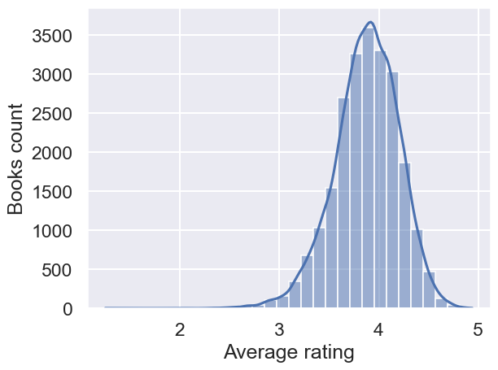



EDA
Notes:
Due to time processing and memory size created a function to extract a random sample from the books 5% for processing.

Slide 7
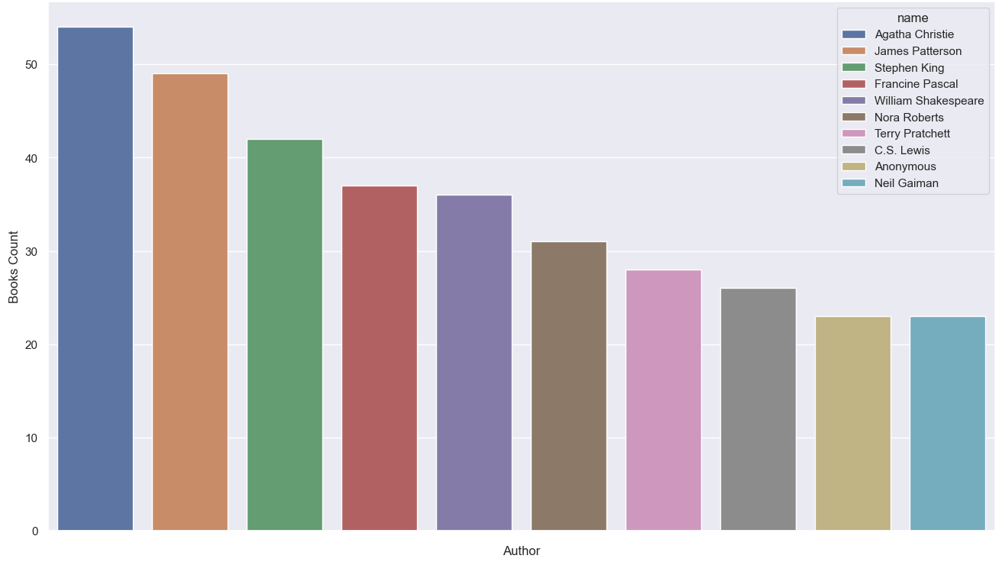
EDA
Notes:
Due to time processing and memory size created a function to extract a random sample from the books 5% for processing.

Slide 8
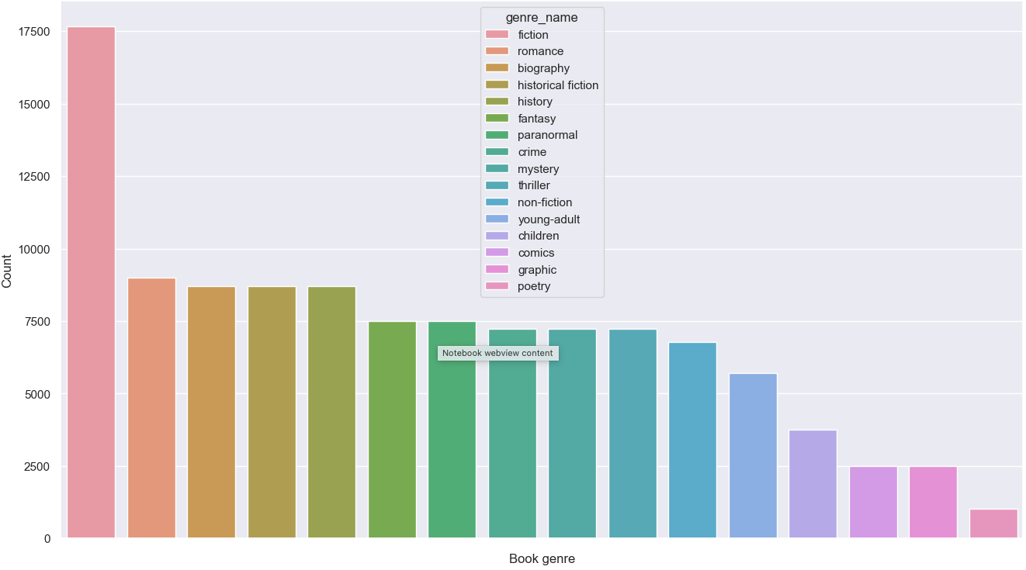
EDA
Notes:
Due to time processing and memory size created a function to extract a random sample from the books 5% for processing.

Slide 9
Data Cleaning
Clean text fields
Remove spaces
Choose columns for project
Remove columns not needed
Reusable functions
Created functions that can be reused for cleaning in case of new sample selection.
Clean special characters (reviews)
Remove stop words (reviews)
Lemmatize (reviews)

Slide 10
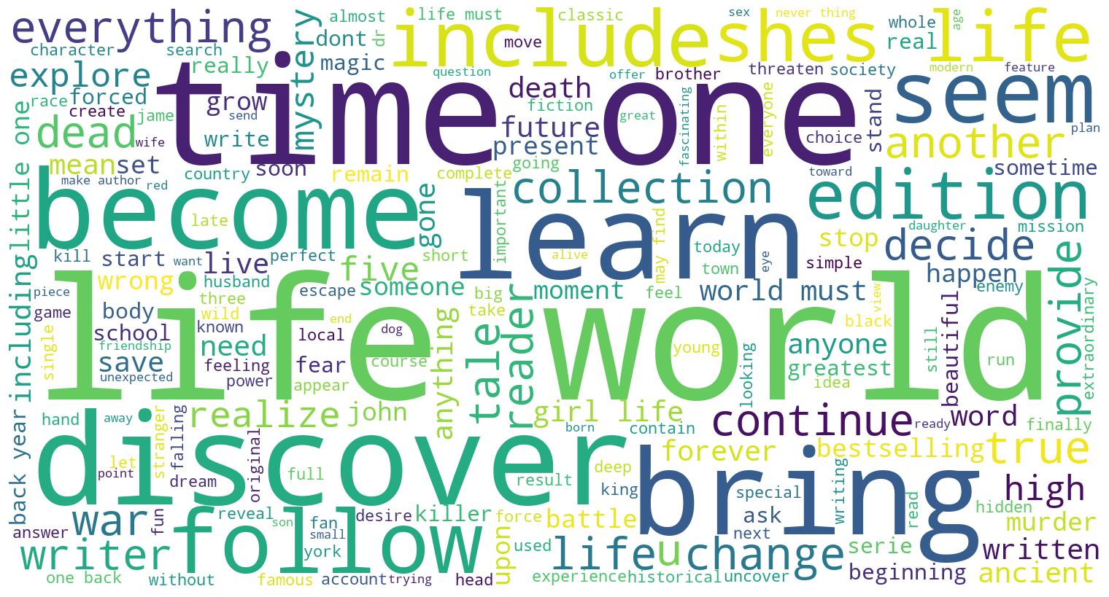
Common words books description
Notes:
Common words on books description

Slide 11
Feature Engineering
- Created a list of book genres
- Used book description to create a keywords list
- Created a corpus based on the book description and book genres
NLP
Clean Text
Remove stop words
Lemmatize
TFIDF Vectorizer
Notes:
Clean text: remove puntiation, lowercase, remove special chars if any, numbers from text

Slide 12

Methods Used
Cosine of similarity for keywords and corpus
Calculation of Kmeans with user rating
Use of SVD for predicting user rating
Added sentiment analysis for suggested books based on reviews text
Added Google Books API to bring a link for more information.

Slide 13

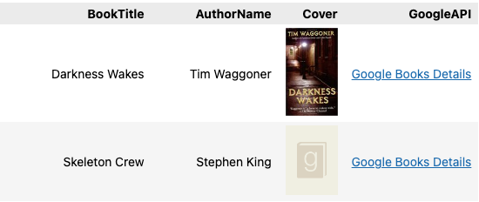
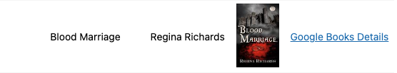
Results content-based
Notes:
Used Dr Sleep

Slide 14
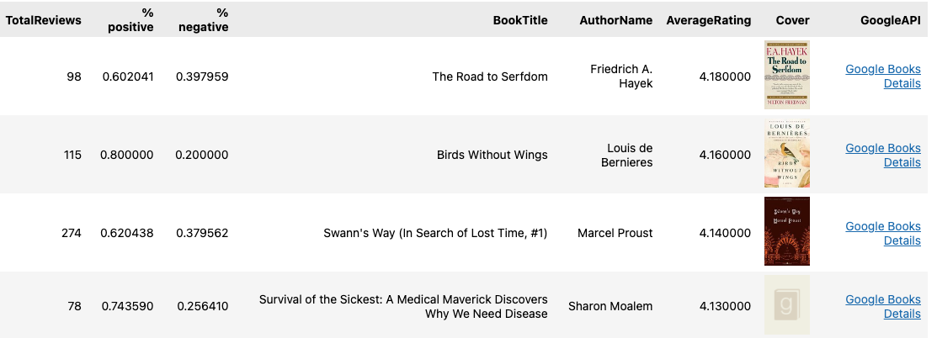


Results user based
Notes:
Transformer distilbert for sentiment analysis

Slide 15
Further Development
Deployment
Explore more options for recommenders and optimize
Add Amazon Product Advertising API to offer a purchase option

Slide 16

Thank You!
hugo.perdomo@gmail.com
https://www.linkedin.com/in/hugo-perdomo/
https://github.com/hapl/

